Slide 1
Risk Management Meeting
ACS (M)
May 2018
Notes:
1

Slide 2
PERSONAL FINANCING
Notes:
2

Slide 3
PERSONAL FINANCING BUSINESS - RMM
Agenda:
Product Level KRIs
PF Product Share
Customer Income Band by FA Composition
Market Receivables
Competitors Campaign Activities
Notes:
3

Slide 4
Summary of KRI
KRI | Threshold |  |  | March’18 | April’18 | May’18
 | Satisfactory | Alert | Critical
NPL Ratio | < 2.06% | 2.06% - 2.56% | > 2.56% | 2.01% | 1.98% | 2.08%
NCC Ratio | < 4.02% | 4.02% - 6.20% | > 6.20% | 2.87% | 3.04% | 3.64%
Effective Interest Rate | > 18.25% | 15.26% - 18.25% | < 15.26% | 18.57% | 17.71% | 18.06%
Note :
May 2018 NPL Ratio increased by 0.1% MOM.
May 2018 EIR (18.06%) had improved by 0.35% vs. Apr 2018. Average income increased MOM by 0.5% (1.41mil).

Slide 5
Product Level KRIs (NPL ratio %)
Data %
Satisfactory | Alert | Critical
< 2.06% | 2.06% - 2.56% | > 2.56%
May 2018 NPL ratio is within Alert range at 2.08%. MOM increased by 0.1% (Apr 2018 : 1.98%)

Slide 6
Product Level KRIs (NCC ratio %)
Data %
Satisfactory | Alert | Critical
< 4.02% | 4.02 – 6.20 | > 6.20%
May 2018 NCC ratio is within Satisfactory range at 3.64%. MOM increased by 0.6% (May’18 NCC : RM 7.3mil)

Slide 7
Product Level KRIs (Effective Interest Rate % )
Data %
Satisfactory | Alert | Critical
> 18.25% | 15.26% - 18.25% | < 15.26%
May 2018 EIR% is within Alert at 18.06%. MOM EIR increased by 0.35%.

Slide 8
S&P by Product Share % (Normal, Express, Low Interest, Refinancing)
Count (%)
S&P Count ’Avg | Normal | Express | Low Interest | Refinancing | Total
Mar’18 | 2,493 | 2,489 | 439 | 882 | 6,303
Apr’18 | 2,587 | 2,525 | 576 | 902 | 6,590
May’18 | 2,313 | 2,347 | 522 | 886 | 6,068
New Customers had decreased MOM by 10.6% May 2018. Total Customers in May’18 decreased by 7.9% vs. Apr’18.

Slide 9
Customer Income Band by FA (S&P) Composition (Q3FYE18 – Q1FYE19)
S&P Count %
Inc.Band
MOM | Mar’18 |  |  |  | Apr’18 |  |  |  | May’18
FA | <18K | 18-24K | 24-36K | >36K | <18K | 18-24K | 24-36K | >36K | <18K | 18-24K | 24-36K | >36K
<5K | 104 | 84 | 255 | 168 | 102 | 121 | 230 | 161 | 118 | 95 | 272 | 170
5-10K | 282 | 241 | 519 | 401 | 278 | 278 | 544 | 425 | 240 | 249 | 510 | 382
10-15K | 372 | 466 | 941 | 769 | 397 | 440 | 950 | 729 | 359 | 407 | 854 | 748
15-20K | 57 | 140 | 369 | 395 | 70 | 163 | 370 | 369 | 44 | 105 | 326 | 358
>20K | 2 | 17 | 212 | 509 | 4 | 29 | 260 | 670 | 2 | 31 | 226 | 572
FA band >20K in May’18 decrease by 13.7% MOM. Total on FA band >20K in May’18 : 831 vs. Apr’18 : 963

Slide 10
Profitability Measurement (May’17 – May’18)
Profitability (%)
FYE2018 | May’17 | Jun'17 | July'17 | Aug'17 | Sept’17 | Oct’17 | Nov’17 | Dec’17 | Jan'18 | Feb’18 | Mar’18 | Apr’18 | May’18
Actual Profitability | 36.1% | 43.8% | 34.4% | 41.7% | 41.0% | 35.3% | 39.0% | 38.5% | 36.3% | 40.0% | 48.6% | 42.3% | 54.5%
Budgeted Profitability | 42.8% | 48.3% | 51.0% | 52.4% | 36.3% | 52.7% | 52.9% | 53.9% | 54.7% | 54.5% | 50.5% | 53.8% | 52.0%
Profitability (%) = Profit Before Support Cost / Revenue

Slide 11
Risk Management : Market Receivables
(Unit :RM' Million)
NO. | BANK | Q4FYE18 | Q1FYE19 | Q1 vs.Q4 (%) | NO. | BANK | Q4FYE18 | Q1FYE19 | Q1 vs.Q4 (%)
1 | MBSB | 22,506 | 20,313 | 90.3% | 9 | OCBC Bank | 1,439 | 1,522 | 106%
2 | CIMB | 13,116 | 13,071 | 99.7% | 10 | Standard Chartered | 975 | 957 | 98%
3 | Bank Islam | 12,368 | 12,725 | 102.9% | 11 | Affin Bank | 661 | 713 | 108%
4 | Public Bank | 6,629 | 6,784 | 102.3% | 12 | RHB Bank | 6,225 | N/A
5 | Maybank | 6,352 | 6,303 | 99.2% | 13 | Bank Muamalat | 823 | N/A
6 | Hong Leong Bank | 2,316 | 2,207 | 95.3% | 14 | Citibank | N/A | N/A
7 | ACSM | 1,916(Feb) | 1,960 | 102.3% | 15 | Al-Rajhi | N/A | N/A
8 | Alliance Bank | 3,045 | 1,939 | 63.7%
N/A : Not Available

Slide 12
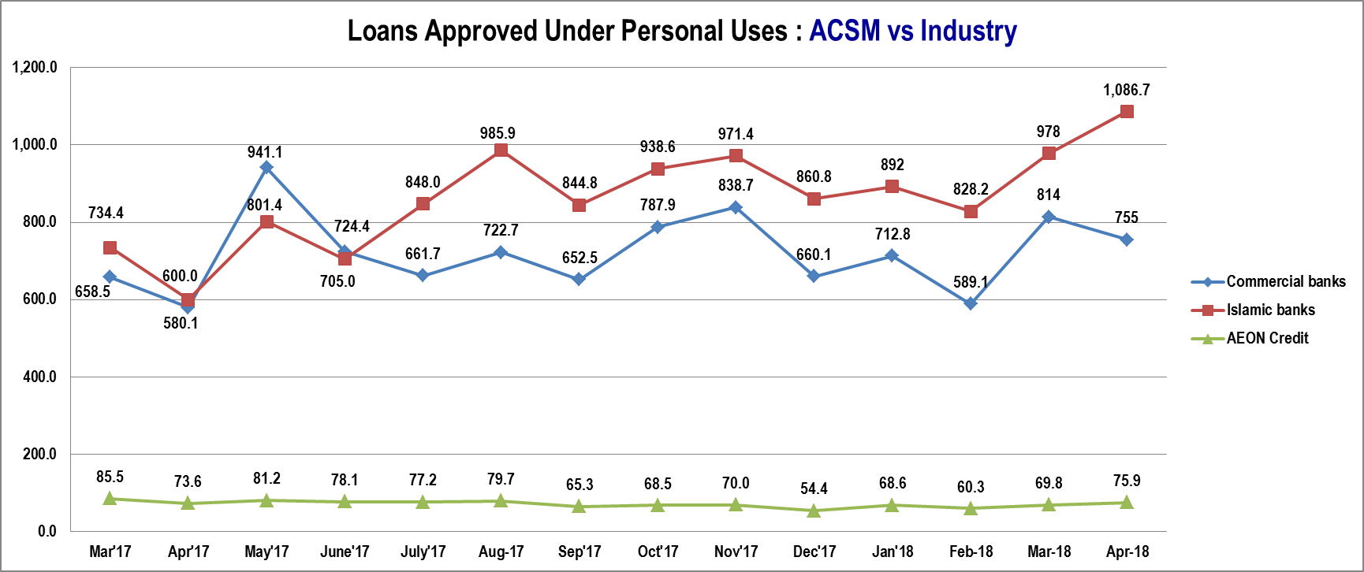
Personal Financing Industry Comparison
(Source : BNM Statistic)

Slide 13

Personal Financing (Risk Category: Market Risk: New & existing campaign)
Campaign | AEON i-CASH | Features
ACS Campaign |  | Apply ACS Online Campaign Eligibility : Open to All New Application submit via Online channel Application & S&P Date : 1st June – 31st July 2018, Sign S&P 15th Aug 2018 Rewards : Cash back will be rewarded based on Approved Loan amount FA : >RM50,000 : 2% cash back FA : RM10,000 – RM49,999.99 : 1% cash back FA : RM1,000 - RM 9,999.99 : 0.5% cash back

Slide 14

Personal Financing (Risk Category: Market Risk: New & existing campaign)
Campaign | AEON i-CASH | Features
ACS Campaign |  | 1) SenangRaya “AEON i-Cash” Campaign Eligibility : Open to New and Existing customer who submitted with complete supporting documents via All channels. FA Amount : RM1,000 – RM100,000 Application & S&P Date : 21st May – 31st Aug 2018, S&P by 15th Sept 2018. Rewards : Special Profit Rate as low as 0.66% per month for Monthly income > RM2,000. For income <RM2,000 Profit Rate 1.2% - 1.5% per month. (subject to assessment). 2) SenangRaya “AEON i-Cash” Campaign Eligibility : New and Existing customer who submitted with complete supporting documents via All channels except Web. FA Amount : RM5,000 – RM100,000 Application & S&P Date : 1st May – 30 June 2018. Sign S&P by 15th July 2018. Rewards : RM50 & RM100 Petronas Gift card.

Slide 15


Personal Financing (Risk Category: Market Risk: New & existing campaign)
Campaign | Hong Leong Personal Loan | Features
Hong Leong Campaign |  | Eligibility : Malaysian Citizen, Age between 21- 60 years Minimum Gross Income : RM2,000 New Application only (Customer does not have an existing PL in HLB / HLIB) Feature / Rewards : Lower rates 6% p.a. RM200 Welcome bonus Anti Theft backpack for first 100 applicant Campaign Duration : 28 May 2018 - 06 July 2018
 |  | Eligibility Open to Malaysian citizens Aged between 21 to 60 years old Earn an annual income of RM24,000 p.a. Campaign Duration : Apply on 1st Mar 2018 - 31st Aug 2018. Disbursed by 15th Sept 2018. FA : RM5K- RM250K. Disburse to Travel Partner’s account base on travel / cruise packages. Interest Rate : 5% - 8% p.a. Submission Gift : Dashboard camera or Anti- theft bag.

Slide 16

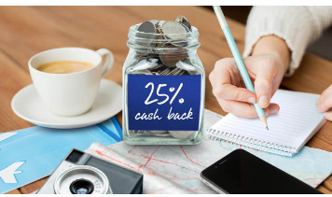
Personal Financing (Risk Category: Market Risk: New & existing campaign)
Campaign | Cash Plus Personal Loan | Features
CIMB Campaign |  | Eligibility : Malaysian Citizen, Age 21- 58 yrs. Min Income RM2,000, In employment more than 6 months. For Self Employed; Business to be more than 24 months. Campaign Period : 1 May - 31 July 2018 Application Channel : All Channels Cimb Sales Channel : Each RM1,000 disbursed = 1x ENTRY Web Channel : Each RM1,000 disbursed for complete online submission = 3x ENTRY FA : RM2K – RM100K, Up to 5 years tenure. Rewards : i) Grand Prize 3 X Perodua Myvi ii) 300 X RM200 Petronas Gift Card Subject to Loan Application is Approved and fully disbursed.
Campaign | UOB Personal Loan | Features
UOB Campaign |  | Eligibility : Open to New and Existing Customer of UOBM. Malaysian Citizen or PR, Age between 21- 55 years Minimum Gross Income : RM2,000 Feature / Rewards : Eligible to receive 25% interest rebate on total interest payable, subject to monthly instalment is paid on or before the due date during the entire tenure. Campaign Duration : 1st Apr – 30th Sept 2018. Disburse by 31st Oct 2018.

Slide 17





Personal Financing Campaign Market Comparison
Bank / FI | Ringgit Plus | Features | Duration | Rewards
 | Ringgit plus promotions | Apply via Ringgitplus, FA:RM5K- RM150K.Tenure 1 - 7yrs | 1st June 2018 - 20th July 2018 | 1 x Acer Iconia One 7 Tablet or 1 x Khind Multi Cooker, RM40 worth of Agoda e-Voucher, 1-year iflix subscription
 | Ringgit plus promotions | Apply via Ringgitplus, Approved & disbursed FA > 20K | 06th June’17 - 30th June’18 | RM100 Touch ’n Go Card
 | Ringgit plus promotions | Apply via Ringgitplus, FA:RM21K- RM150K Tenure 1 - 5yrs | 1st June 2018 - 20th July 2018 | 1 x Acer Iconia One 7 Tablet or 1 x Khind Multi Cooker, RM40 worth of Agoda e-Voucher, 1-year iflix subscription
 | Ringgit plus promotions | Apply via Ringgitplus, FA:RM5K- RM150K. Tenure 2 - 5yrs | 1st June 2018 - 20th July 2018 | 1 x Acer Iconia One 7 Tablet or 1 x Khind Multi Cooker, RM40 worth of Agoda e-Voucher, 1-year iflix subscription
 | Ringgit plus promotions | Apply via Ringgitplus, FA:RM3K- RM250K. Tenure 1 - 5yrs | 13th Apr – 30th June 2018 | Rates at 6.99% p.a. with complement RM50 Giant Gift Card

Slide 18




Personal Financing Campaign Market Comparison
Bank / FI | Campaign Name | Features | Duration | Rewards
 | Ringgit plus promotions | Apply & disbursed for Min RM10K- RM150K, Tenure 2- 8 years. | 1st June 2018 - 20th July 2018 | 1 x Acer Iconia One 7 Tablet or 1 x Khind Multi Cooker, RM40 worth of Agoda e-Voucher, 1-year iflix subscription
 | Ringgit plus promotions | Apply via Ringgitplus, FA: RM5K-RM250K. Tenure up to 10 years | 10th Oct 2017 – 10 Oct 2018 | RM50 Giant Voucher
 | Ringgit plus promotions | Apply via Ringgitplus, FA: RM500 -RM50K. Tenure 1 - 5 years | 10th Aug 2017 – 31st Dec 2018 | RM30 AEON Voucher
 | Ringgit plus promotions | Apply via Ringgitplus, FA: RM2K –RM200K. Tenure 2 - 10 years | 18th Apr 2018 – 31st May 2018 | RM50 Giant Voucher

Slide 19


Personal Financing (Risk Category: Market Risk: New & existing campaign)
Campaign | UKHWAH Cash-i | Features
Ringgitplus rewards |  | Eligibility : Apply online via Ringgit plus website and subsequently approved and disbursed by Ukhwah. Open to Government Personal or GLC who salary is deducted from Angkasa. FA : RM2,000 – RM 200,000 Tenure : 2 - 10 years. Campaign Durations : 18th Apr 2018 – 31st May 2018. Disbursed by 31st July 2018. Rewards: RM50 Giant Voucher
 | JCL
 |  | Eligibility : Open to all customers apply online via Ringgit plus website and are subsequently approved and disbursed by JCL . FA : RM500 – RM 50,000. Tenure : 1 - 5 years. Campaign Durations : 10 Aug 2017 – 31st Dec 2018. Approved by JCL by 1st Mar 2019. Rewards: RM30 AEON Voucher

Slide 20

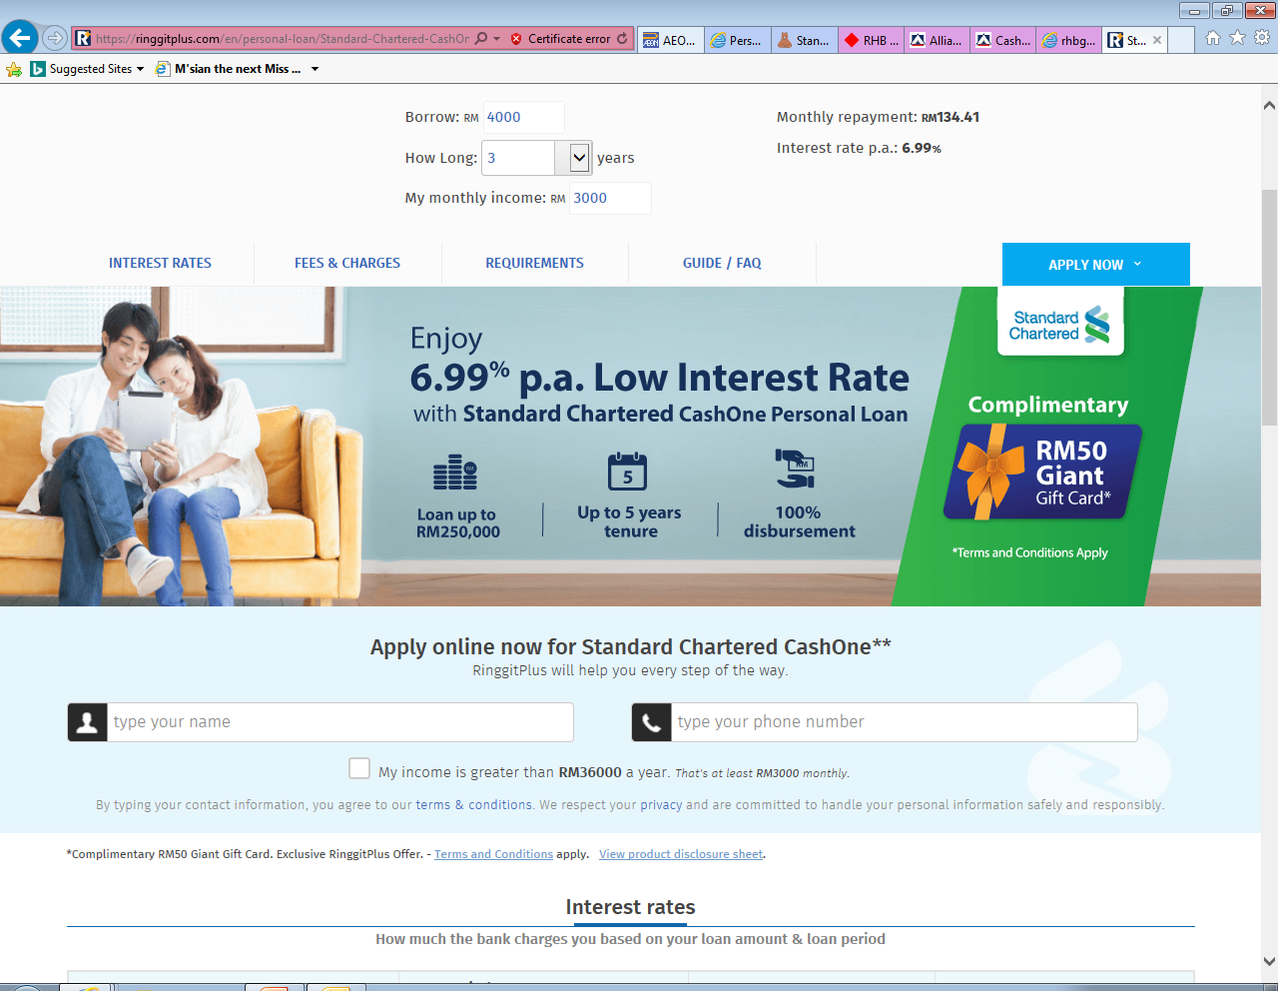
Personal Financing (Risk Category: Market Risk: New & existing campaign)
Campaign | Alliance Bank | Features
Ringgitplus rewards |  | Eligibility: Open to all customers who applied via Ringgit plus website. Min income : RM 3K monthly FA RM5,000 - RM150,000. Tenure : 12- 84 Months Campaign Durations: Application on 1st June – 20th July 2018. Rewards: 1 x Acer Iconia One 7 Tablet or 1 x Khind Multi Cooker, RM40 worth of Agoda e-Voucher, 1-year iflix subscription
 | Standard Chartered
Ringgitplus rewards |  | Eligibility : Open to New to bank customers. Apply for SC CashOne via online and Successfully disbursed. FA : 3K - 250K, Tenure : 1- 5 years. Campaign Durations: 13th Apr – 30th June 2018 Rewards: RM 50 Giant Gift Card

Slide 21
Personal Financing (Risk Category: Market Risk: New & existing campaign)
Campaign | Easy by RHB - Easy Pinjaman Ekspres | Features
Ringgitplus rewards |  | Eligibility: Open to all customers who applied via Ringgit plus website and submit the application at any RHB Easy Branch during the campaign period, and are then subsequently approved and disbursed. FA : RM21K – RM150K Campaign Durations: 1st June 2018 - 20th July 2018 Rewards : 1 x Acer Iconia One 7 Tablet or 1 x Khind Multi Cooker, RM40 worth of Agoda e-Voucher, 1-year iflix subscription
 | Citibank
Ringgitplus rewards |  | Eligibility: Apply Personal Loan via online at Ringgitplus website and subsequently approved and disbursed. FA : RM5K- RM150K. Tenure : 2 - 5 years Campaign Durations: 1st June 2018 - 20th July 2018 Rewards : 1 x Acer Iconia One 7 Tablet or 1 x Khind Multi Cooker, RM40 worth of Agoda e-Voucher, 1-year iflix subscription

Slide 22
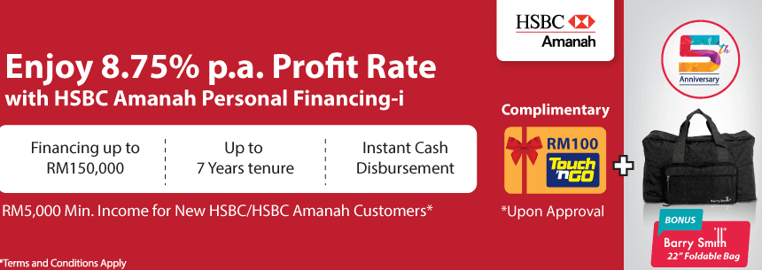
Personal Financing (Risk Category: Market Risk: New & existing campaign)
Campaign | HSBC Amanah Personal Financing - i | Features
Ringgitplus rewards |  | Eligibility: Open to customers apply online via Ringgit plus website and are subsequently approved and receive financing for more than RM20,000. New Customer : Minimum income 5K. Existing Customer : Minimum income 3K. FA RM20,000 and above. Tenure up to 7 years to entitle for (profit rate) 8.75% p.a. Campaign Durations: 06th June’17 - 30th June 2018. Rewards : FA > 20K Approved & Disbursed : RM100 Touch ‘n Go Card.
 | Al Rajhi Personal Financing-i | Features
 |  | Eligibility : Apply Personal Financing via online at Ringgitplus website and subsequently approved and disbursed. Min Income : 60K per annum. Mechanics : Financing amount : RM10,000 -RM150,000. Tenure : 2 - 8 years . Campaign Period : 1st June – 20th July 2018. Rewards : 1 x Acer Iconia One 7 Tablet or 1 x Khind Multi Cooker, RM40 worth of Agoda e-Voucher, 1-year iflix subscription

Slide 23

Personal Financing (Risk Category: Market Risk: New & existing campaign)
Campaign | RHB Personal Financing | Features
Ringgitplus rewards |  | Eligibility : Open to all customers apply online via Ringgit plus website and are subsequently approved and disbursed. FA RM5,000 – RM250,000. Tenure 2 - 10 years. Campaign Durations : 10th Oct 2017 – 10 Oct 2018, Approved and Successfully disbursed by 31st Nov 2018 Rewards: RM50 Giant Voucher.

Slide 24
Thank
You

Slide 25



Personal Financing (Risk Category : Market Risk)
Items
Product Name | Cash First Personal Loan Cash Vantage Financing-i | Personal Financing-i | Personal Financing -i
Finance Amount | RM5,000 – RM150,000 | RM5,000 – RM250,000(6 to 9x salary) | Package Personal Financing: RM10,000 – RM200,000 Non-package Personal Financing: RM 10,000 – RM150,000
Interest Rate | 8.38% p.a. for RM5,000 For 7 years tenure | 9% - 13.5% p.a. | Non Package Personal Financing-I : 6% to 7%p.a. with takaful. 7% to 8% p.a. without takaful. On-package Personal Financing-I : 4.99% p.a.
Tenure | 12 – 84 months | 24 – 84 months | 12 - 120 months
TAT | 24 hours | 48 hours | Fast approval
Min. Salary | RM3,000 | RM2,000 | Package Personal Financing: RM2,000 Non-package Personal Financing: RM 3,500
Min Installment | RM 94 | RM103 | RM883.30
LPC. | 1% p.a. on overdue amount | 1% p.a. on the amount in arrears | 1% p.a. on overdue installment until date of full payment
Processing Fee | NIL | NIL | NIL
Disbursement | IBG/IBFT | IBG - 3 working days | -
Docs Required | MyKad, Disbursement Account particulars, 1 or 3 months pay slip or Latest 6 months EPF Statement or Form BE / EA. | Mykad, 3 months pay slip, 2 months EPF , B/BE Form & 6 months personal bank statement | MyKad & 3 months pay slip, Latest employers confirmation letter, or latest 3 months Bank Statements of salary crediting account, latest tax income form or EPF statement.

Slide 26



Personal Financing (Risk Category : Market Risk)
Items
Product Name | Maybank Islamic Personal Financing | Easy-Pinjaman Express | Quick Cash Edge
Finance Amount | RM5,000 – RM100,000 | RM2,000 – RM150,000 | RM4000 - RM250,000
Interest Rate | 11% p.a. : RM5,000 - RM20,000 10% p.a. : RM20,001 - RM 50,000 9% p.a. : RM50,001 – RM 100,000 | 8.18%p.a. – 13.38%p.a. | 6.996% p.a.
Tenure | 1 - 6 years | 12 – 84 months | 12 – 84 months
TAT | Fast Approval | 10mins | Fast approval
Min Salary | RM 2,500 | RM1,500 | RM 2,000
Min Installment | RM115.28 | RM57.54 | -
LPC. | 1% p.a. on the amount in arrears | 1% of overdue amount | 1% of overdue amount
Processing Fee | N/A | N/A | N/A
Disbursement | - | 10mins after approval | 1day after approval
Docs Required | MyKad, Latest 2 months salary slips and Latest 6 months Account Statement or Latest BE form with official tax receipt and Business Registration | MyKad , Salary Slip, EPF Statement & Bank Statement | MyKad, 1month pay slip & Bank Statement, EPF statement or BE form

Slide 27


Personal Financing (Risk Category : Market Risk)
Items
Product Name | Personal Financing-i | Personal Loan - AmMoneyLine | Maybank Personal Loan
Finance Amount | RM4,000 - RM250,000 | RM2,000 – RM100,000 | RM5,000 – RM100,000
Interest Rate | Fixed profit rate at 6.99% p.a. | 8.0% p.a. to 11.99% p.a. | 8% p.a. : RM5K - RM20K 7% p.a. : RM20K - RM50K 6.5% p.a. : RM50K - RM100K
Tenure | 12 - 60 months | 12 – 60 months | 24 - 72 months
TAT | 14 days | 48 hours | 10mins
Min Salary | RM1,000 | RM2,000 | RM2,500
Min Installment | - | RM104 | RM102.78
LPC | 1% p.a. of overdue installment | 1% p.a. of overdue installment | 1% p.a. of overdue amount
Processing Fee | NIL | NIL | NIL
Disbursement | - | - | 10mins after approval
Docs Required | MyKad, 3 months pay slip, bank statement & Form J/EA/EC | MyKad, 3 months pay slip & 3 months bank statements or latest EPF statement | MyKad, latest BE form with official tax receipt, 3 months pay slip, & 6 months bank statement

Slide 28


Personal Financing (Risk Category : Market Risk)
Items
Product Name | Xpress Cash Financing-i | Cash Plus Personal Loan | Personal Financing-i
Finance Amount | RM3,000 – RM50,000 or 8x gross income | RM2,000 – RM100,000 or 8x gross income | RM5,000 – RM200,000
Interest Rate | 18% - 24% p.a. | Salaried, RM50,000-RM100,000 : 8.2% p.a. Salaried, RM20,000-RM49,900 : 10.88% p.a. Salaried, RM2,000-RM19,900 : 14.66% p.a. Self Employed, RM2,000-RM100,000 :14.66% | 4.3% p.a. : Biro Perkhidmatan Angkasa 6.9% p.a. : Selected private and government-linked companies
Tenure | 6 – 60 months | 12 – 60 months | 24 – 48 months
TAT | 24hrs (via TMK). Web / Branch: 7 days | 24hrs (via TMK). Web / Branch: 7 days | -
Min Salary | RM800 | RM2,000 | RM1,500
Min Installment | RM110 | RM58 | RM 122.08
LPC | 1% of overdue installment | 1% of overdue amount | 1% p.a. of overdue installment
Processing Fee | NIL | NIL | Yes
Disbursement | Fast disbursement | Fast disbursement | N/A
Docs Required | MyKad, 3 months pay slip, Bank Statement & EPF Statement | MyKad, 3 months pay slip, Bank Statement & EPF Statement | MyKad, 1 month pay slip & one copy of Saving Account Passbook or Current Account statement

Slide 29

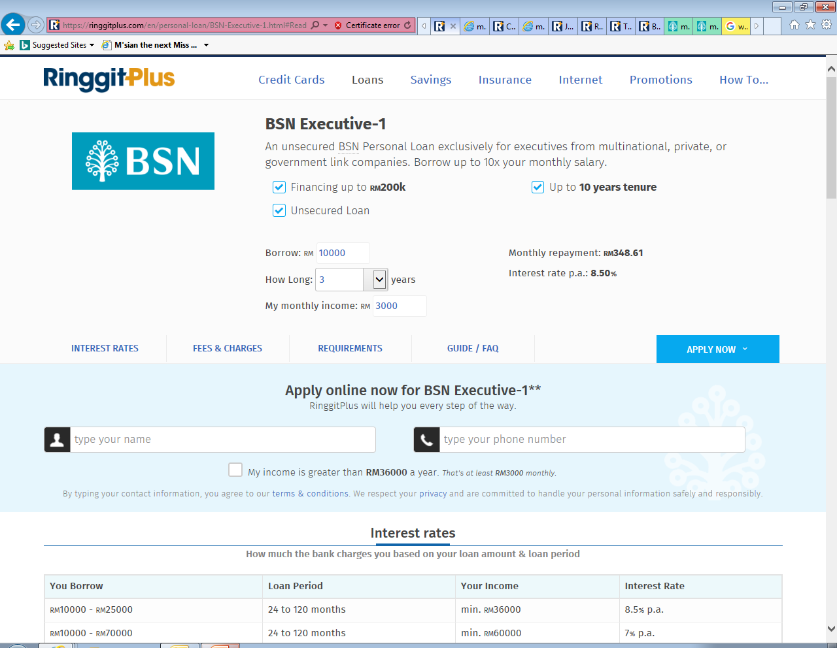

Personal Financing (Risk Category : Market Risk)
Items
Product Name | Personal Financing-i | BSN Executive-1 | Personal Financing-i
Finance Amount | RM5,000 – RM150,000 (up to 5x salary) | RM10,000 – RM200,000 | RM6,000 – RM150,000
Interest Rate | 7.5%p.a. | 6.00% p.a. – 8.50% p.a. | 12.5% p.a. : RM6K – RM19.5K 11.5% p.a. : RM20K – RM49.5K 10.5% p.a. : RM50K – RM150K
Tenure | 12 – 60 months | 2 yrs - 10 yrs | 24 – 84 months
TAT | 48 hours | - | Fast Approval
Min Salary | RM2,000 | RM3,000 | RM3,000
Min Installment | RM90.77 | RM231.25 | RM134
LPC | 1% p.a. of overdue amount | 1% p.a. of overdue installment | -
Processing Fee | Yes | N/A | NIL
Disbursement | CASA Account | N/A | Instant Cash disbursement
Docs Required | 3 months pay slip, BE Form, letter of employment, 6 months EPF & 3 months bank statements | MyKad, 3 months pay slip, latest EPF statement & confirmation letter by employer | MyKad, 3 months pay slip & Form BE

Slide 30

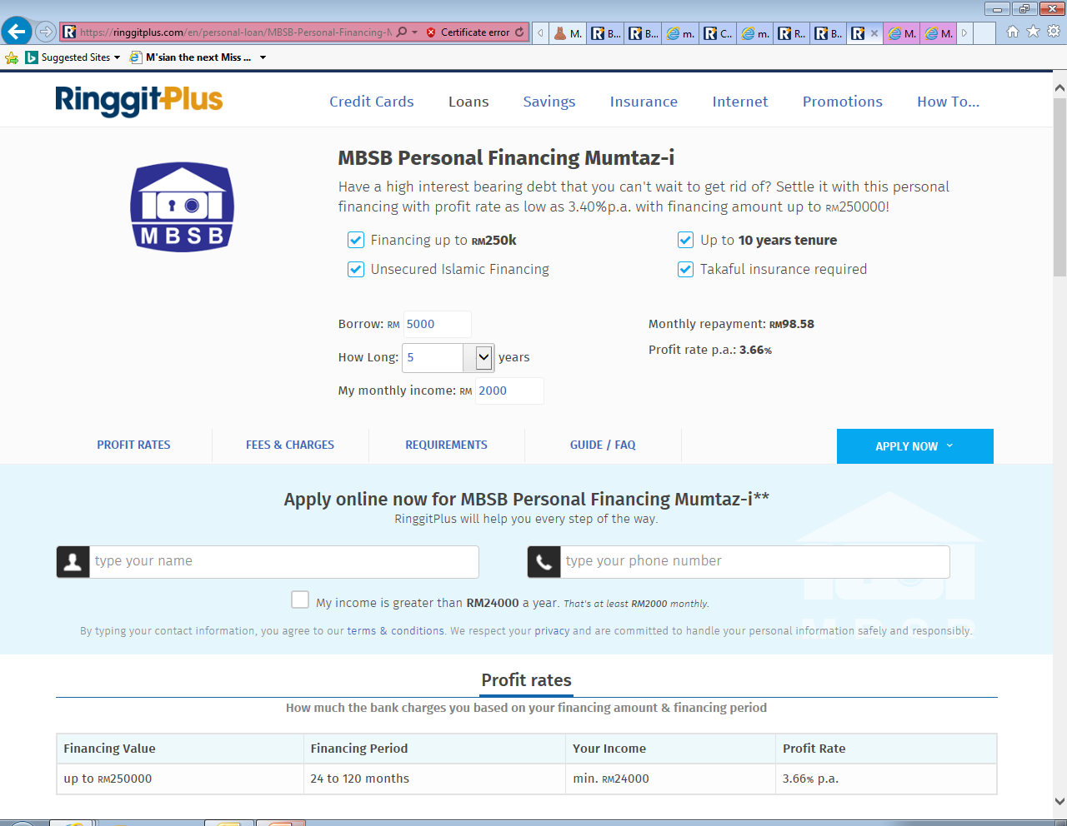
Personal Financing (Risk Category : Market Risk)
Items
Product Name | Personal Financing-i Private Sector | MBSB Personal Financing Mumtaz-i | MBSB Personal Financing Afdhal-i | MBSB Personal Financing-i Private Sector
Finance Amount | RM5,000 – RM150,000(up to 25x monthly gross income) | RM50,000 – RM250,000 | RM50,000 – RM400,000 | RM50,000 - RM300,000
Interest Rate | 4.95% p.a. – 9.37% p.a. | 3.63% p.a. | 4.37% p.a. | 7.43% p.a.
Tenure | 12 – 120 months | 24 – 120 months | 24 – 120 months | 24 -120 months
TAT | - | Fast approval | Fast Approval | Fast Approval
Min Salary | RM 2,000 | RM2,000 | RM15,000 | RM1,000
Min Installment | - | RM569 | RM600 | RM685
LPC. | 1% p.a. of overdue amount | 1% p.a. of overdue installment | 1% p.a. of overdue installment | 1% p.a. of overdue installment
Processing Fee | N/A | Yes | Yes | Yes
Disbursement | CASA Account | N/A | N/A | N/A
Docs Required | Mykad, 3 months pay slip, 3 months bank statements, EPF and Confirm Letter or EA | MyKad, 3 months pay slip, bank account statement | MyKad, 3 months pay slip, bank account statement | MyKad, 3 months pay slip, bank account statement

Slide 31



Personal Financing (Risk Category : Market Risk)
Items
Product Name | AEON i-Cash | I.O.U Personal Loan | Personal Financing-i Public Sector
Financial Amount | RM 1,000 – RM100,000 | RM5,000 – RM250,000 | RM5,000 – RM200,000
Interest Rate | 10.08% - 18% p.a. | 12% p.a. | 3.26% p.a. – 6.53% p.a.
Tenure | 12 – 84 months | 24 – 60 months | 12 – 120 months
TAT | 2-3 days | 1 hour | -
Min Salary | RM 800 | RM2,000 | RM1,000
Min Installment | RM 54 | RM 135 | Floating rate: RM 101 Fixed rate: RM 105
LPC. | 1% p.a. of overdue installment | 1% p.a. of overdue installment | 1% p.a. of overdue installment
Processing Fee | 2% - 4% (Max RM400) | Yes | N/A
Disbursement | IBG / Prepaid Card | CASA Account | CASA Account
Docs Required | 3 months pay slip, EPF & 3 months or 6 months bank statements | 3 months pay slip, BE Form, letter of employment, 6 months EPF & 3 months bank statements | Mykad, 3 months pay slip, 3 months bank statements, EPF and Confirm Letter or EA

Slide 32




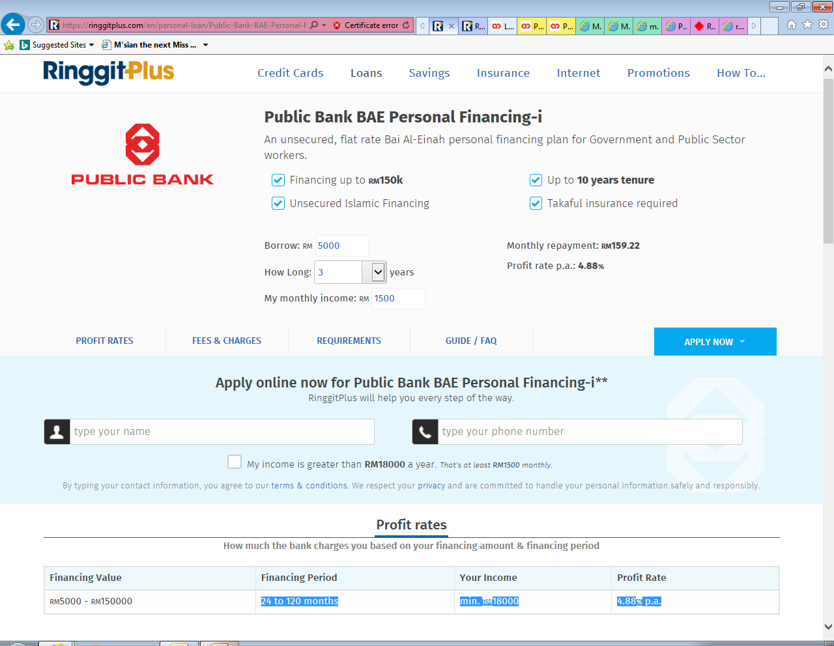
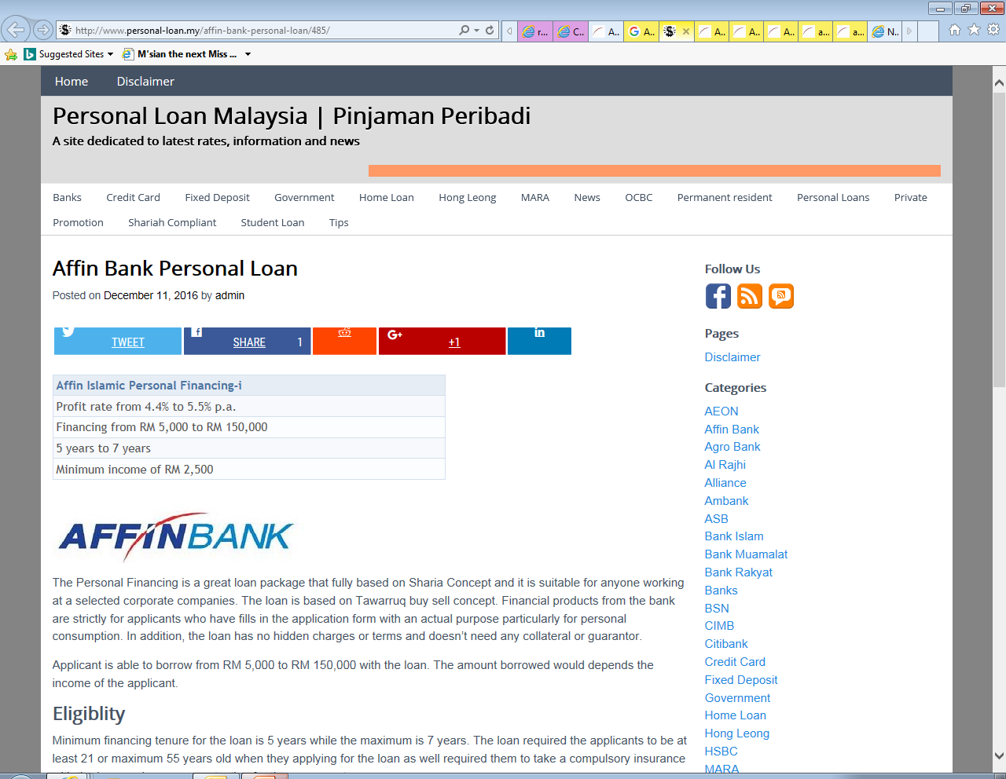
Personal Financing Market Risk
Bank | Product | Interest Rate | Minimum Income | Loan Amount | Max Loan Tenure
 | Citi Bank Personal Loans | 7.9 % p.a. | RM 4,000 | RM5,000 –RM150,000 (up to 8x gross income) | 5 years
 | RHB Personal Finance-i for civil sector | 8.18%p.a. – 15.33% p.a. | RM 2,000 | RM2,000 –RM150,000 | 10 years
 | CashVantage Personal Financing-i | 8.38%p.a. | RM 3,000 | RM5,000 –RM150,000 | 7 years
 | UOB Personal Loan | 9.99%p.a. – 11.99% p.a. | RM 2,000 | RM5,000 – RM100,000 | 5 years
 | Al-Rajhi Personal Financing- i | 6.99% p.a. | RM 5000 | RM5,000 – RM150,000 | 8 years
 | BAE Personal Financing-I (for | 4.88% p.a. | RM 1,500 | RM5,000 – RM150,000 | 10 years
 | Affin Islamic Personal Financing-i | 4.4% p.a. – 5.5 % p.a. | RM2,500 | RM5,000 – RM150,000 | 7 years

Slide 33
Thank
You

